Slide 1


Spring 2021
SKKU Biostats and Big data
CHOONG-WAN WOO | COCOAN lab | http://cocoanlab.github.io

Slide 2
GBME Probability and Statistics
Lecture 23
Lecture 23
Analysis of Variance (ANOVA)
CHOONG-WAN WOO | COCOAN lab | http://cocoanlab.github.io

Slide 3
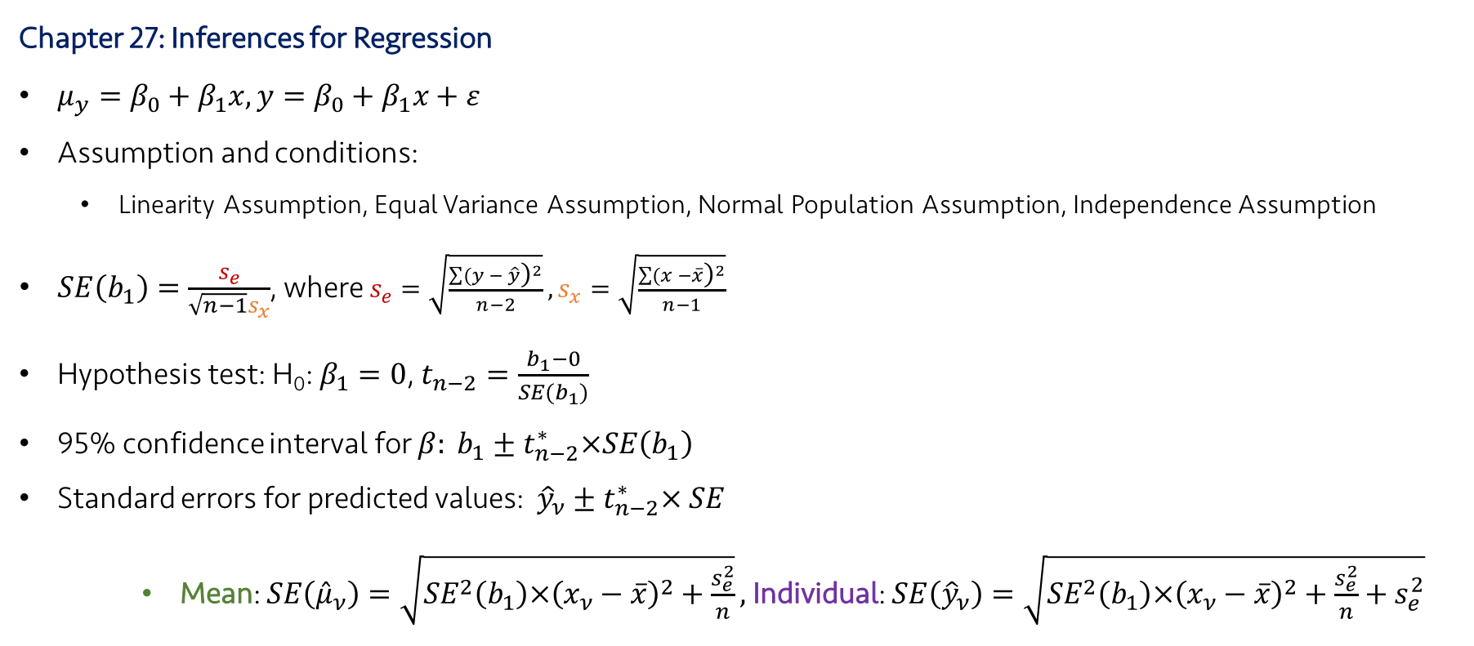
Lecture 23
Review: Key Points
Chapter 27: Inferences for Regression
$μ_{y}=β_{0}+β_{1}x,y=β_{0}+β_{1}x+ε$
Assumption and conditions:
Linearity Assumption, Equal Variance Assumption, Normal Population Assumption, Independence Assumption
$SE\left(b_{1}\right)=\frac{s_{e}}{\sqrt{n−1}s_{x}}$, where $s_{e}=\sqrt{\frac{\sum{{(y − \hat{y}\text{)}}^{2}}}{n−2}},s_{x}=\sqrt{\frac{\sum{{(x −\overline{x}\text{)}}^{2}}}{n−1}}$
Hypothesis test: H₀: $β_{1}=0$, $t_{n−2}=\frac{b_{1}−0}{SE(b_{1})}$
95% confidence interval for $β: b_{1}±t_{n−2}^{∗}×SE\left(b_{1}\right)$
Standard errors for predicted values: ${\hat{y}}_{ν}±t_{n−2}^{∗}× SE$
Mean: $SE\left({\hat{μ}}_{ν}\right)=\sqrt{{SE}^{2}\left(b_{1}\right)×{\left(x_{ν}−\overline{x}\right)}^{2}+\frac{s_{e}^{2}}{n}},$Individual: $SE\left({\hat{y}}_{ν}\right)=\sqrt{{SE}^{2}\left(b_{1}\right)×{\left(x_{ν}−\overline{x}\right)}^{2}+\frac{s_{e}^{2}}{n}+s_{e}^{2}}$
CHOONG-WAN WOO | COCOAN lab | http://cocoanlab.github.io

Slide 4
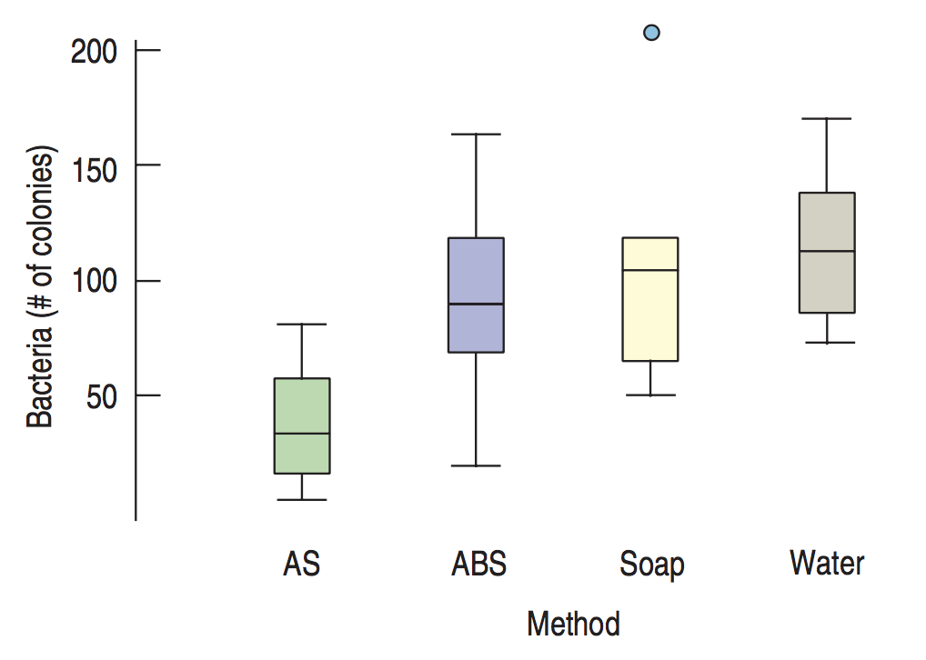
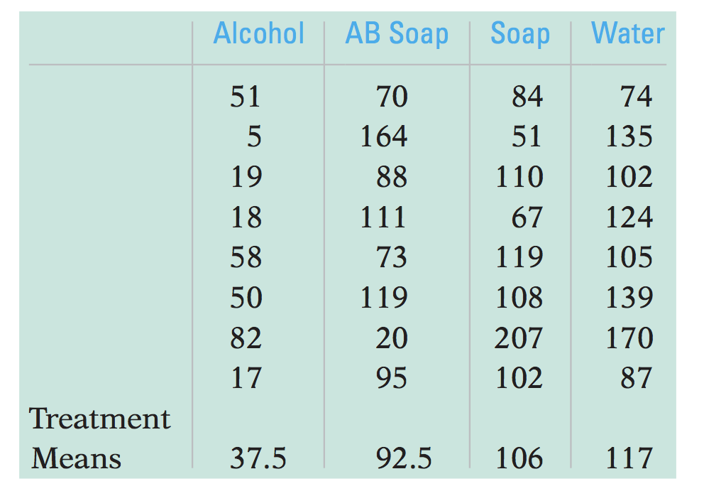
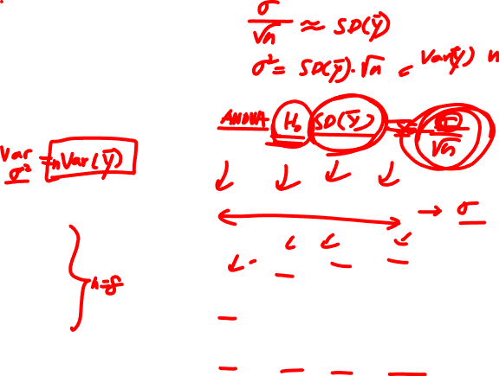
Lecture 23
Example: Washing hands, bacteria colonies
How effective is washing hands with soap in eliminating bacteria?
Comparing four different methods: with water only (Water), regular soap (Soap), antibacterial soap (ABS), spraying hands with antibacterial spray (AS)
Question: are there differences?
# Bacteria colonies
CHOONG-WAN WOO | COCOAN lab | http://cocoanlab.github.io

Slide 5
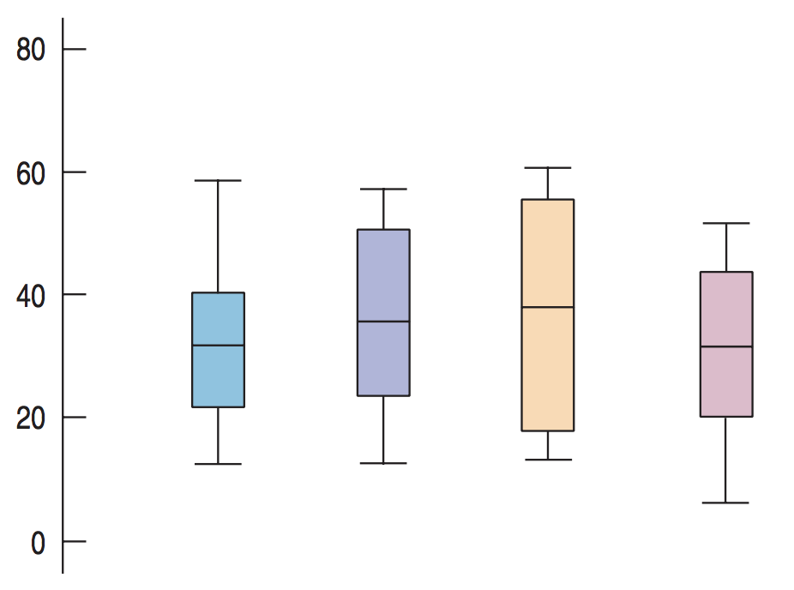
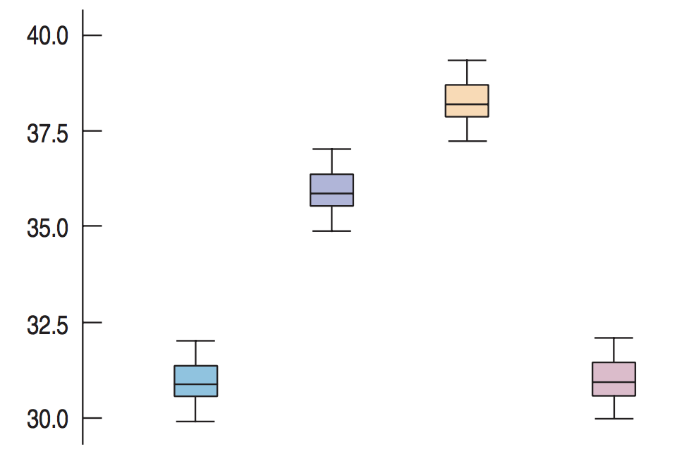
Lecture 23
Intuitions in testing whether the means of several groups are equal
Which one does seem to have same vs. different means?
The mean values in both figures are actually the same. Why do they look different?
In the second figure, the variation within each group is so small that the differences between the means stand out.
Comparing the differences between groups with the variation within the groups: F-test!
CHOONG-WAN WOO | COCOAN lab | http://cocoanlab.github.io

Slide 6
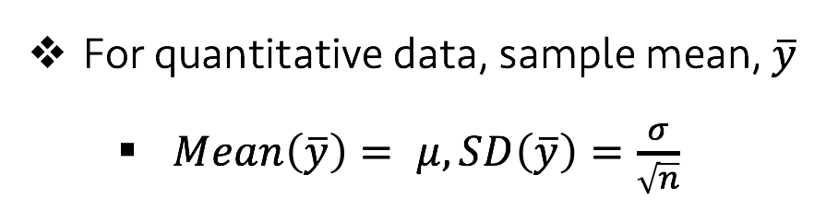
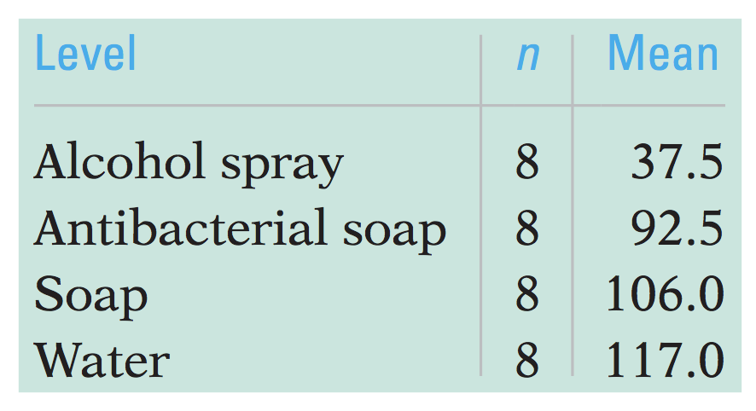
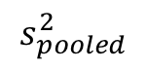
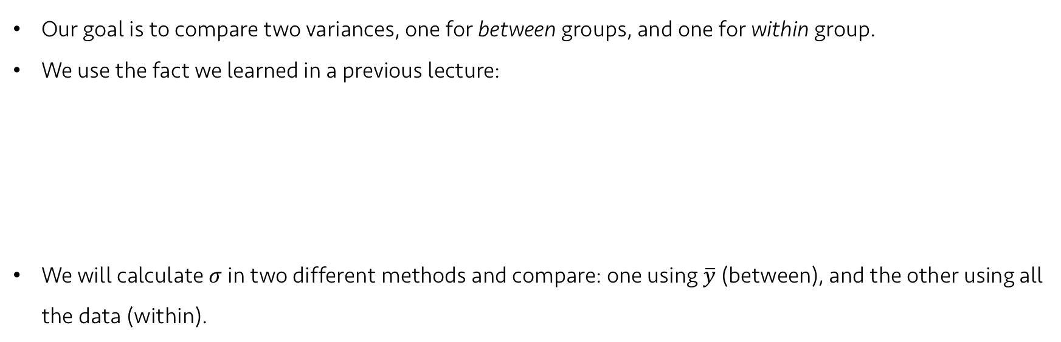
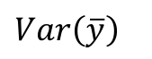
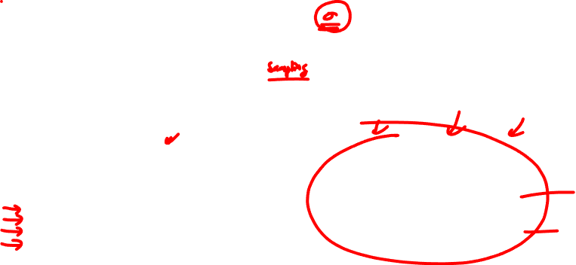

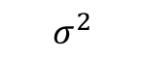
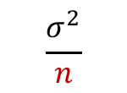
Lecture 23
Differences between and within groups
Our goal is to compare two variances, one for between groups, and one for within group.
We use the fact we learned in a previous lecture:
We will calculate $σ$ in two different methods and compare: one using $\overline{y}$ (between), and the other using all the data (within).
$$\overline{y}$$
$$Var\left(\overline{y}\right)$$
all data
$$s_{pooled}^{2}$$
$$\frac{σ^{2}}{n}$$
$$σ^{2}$$
CHOONG-WAN WOO | COCOAN lab | http://cocoanlab.github.io

Slide 7
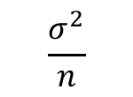
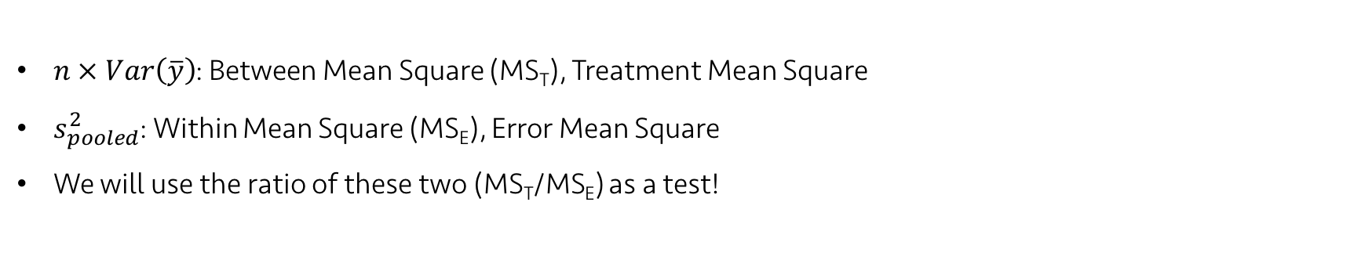
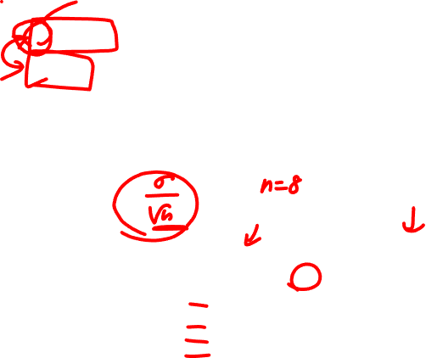
Lecture 23
Differences between and within groups
$n × Var\left(\overline{y}\right)$: Between Mean Square (MS_{T}), Treatment Mean Square
$s_{pooled}^{2}$: Within Mean Square (MS_{E}), Error Mean Square
We will use the ratio of these two (MS_{T}/MS_{E}) as a test!
$$\overline{y}$$
$$Var\left(\overline{y}\right)$$
all data
$$s_{pooled}^{2}$$
$$\frac{σ^{2}}{n}$$
$$σ^{2}$$
CHOONG-WAN WOO | COCOAN lab | http://cocoanlab.github.io

Slide 8
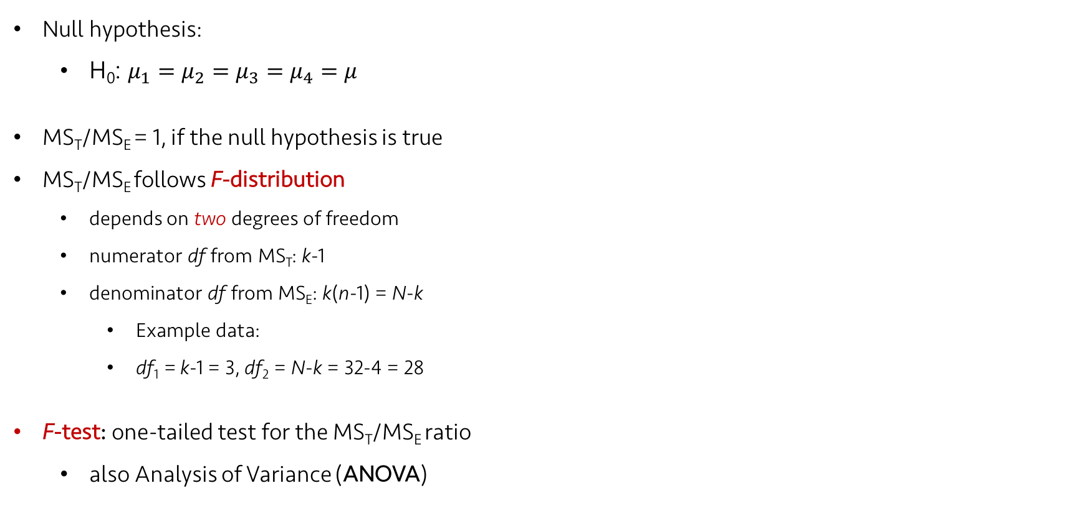
Probability density function
Lecture 23
Hypothesis testing
Null hypothesis:
H₀: $μ_{1}=μ_{2}=μ_{3}=μ_{4}=μ$
MS_{T}/MS_{E} = 1, if the null hypothesis is true
MS_{T}/MS_{E} follows F-distribution
depends on two degrees of freedom
numerator df from MS_{T}: k-1
denominator df from MS_{E}: k(n-1) = N-k
Example data:
df₁ = k-1 = 3, df₂ = N-k = 32-4 = 28
F-test: one-tailed test for the MS_{T}/MS_{E} ratio
also Analysis of Variance (ANOVA)
Cumulative distribution function
https://en.wikipedia.org/wiki/F-distribution
CHOONG-WAN WOO | COCOAN lab | http://cocoanlab.github.io

Slide 9
Lecture 23
Quiz 23-1
https://forms.gle/bQoNGhr9UppVCtJx7
CHOONG-WAN WOO | COCOAN lab | http://cocoanlab.github.io

Slide 10
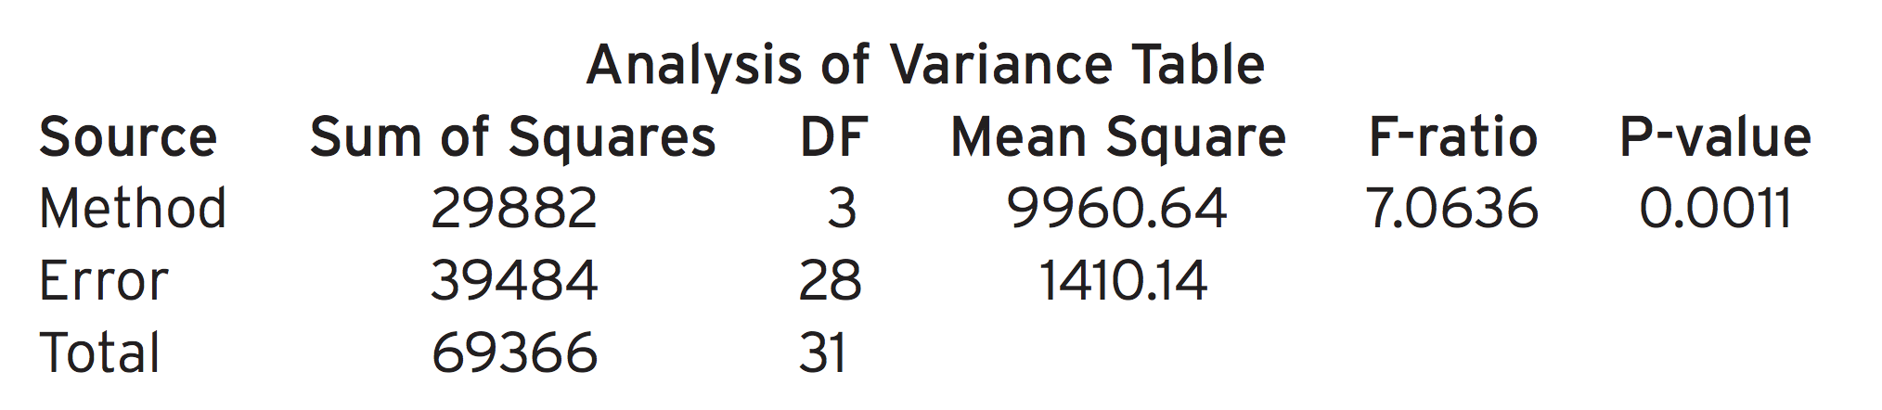
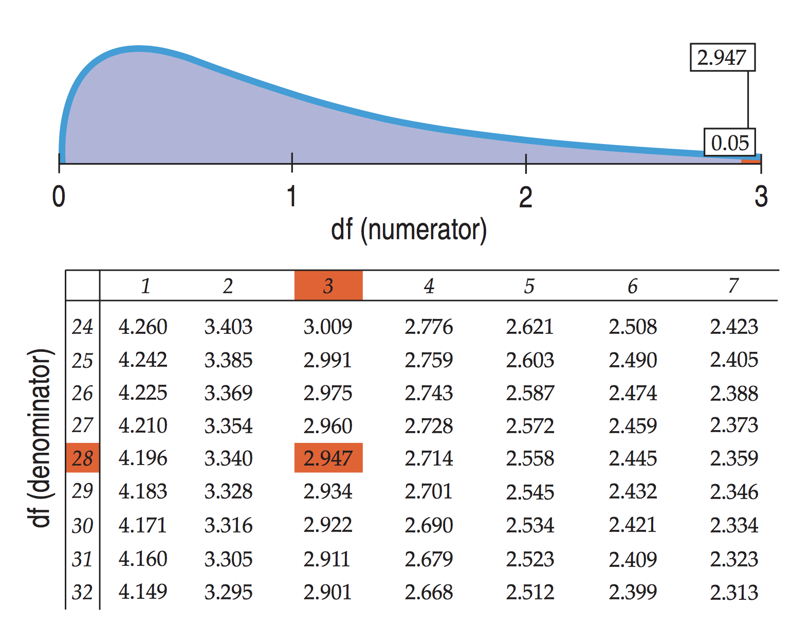


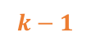

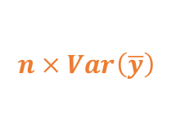
Lecture 23
ANOVA table
has a long history (nearly a century)
Mean Square Between (Treatment): MS_{T}
Mean Square Within (Error, Residual): MS_{E}
$$k−1$$
$$N−k$$
$$n × Var\left(\overline{y}\right)$$
$$s_{pooled}^{2}$$
$$?$$
F-table
CHOONG-WAN WOO | COCOAN lab | http://cocoanlab.github.io

Slide 11
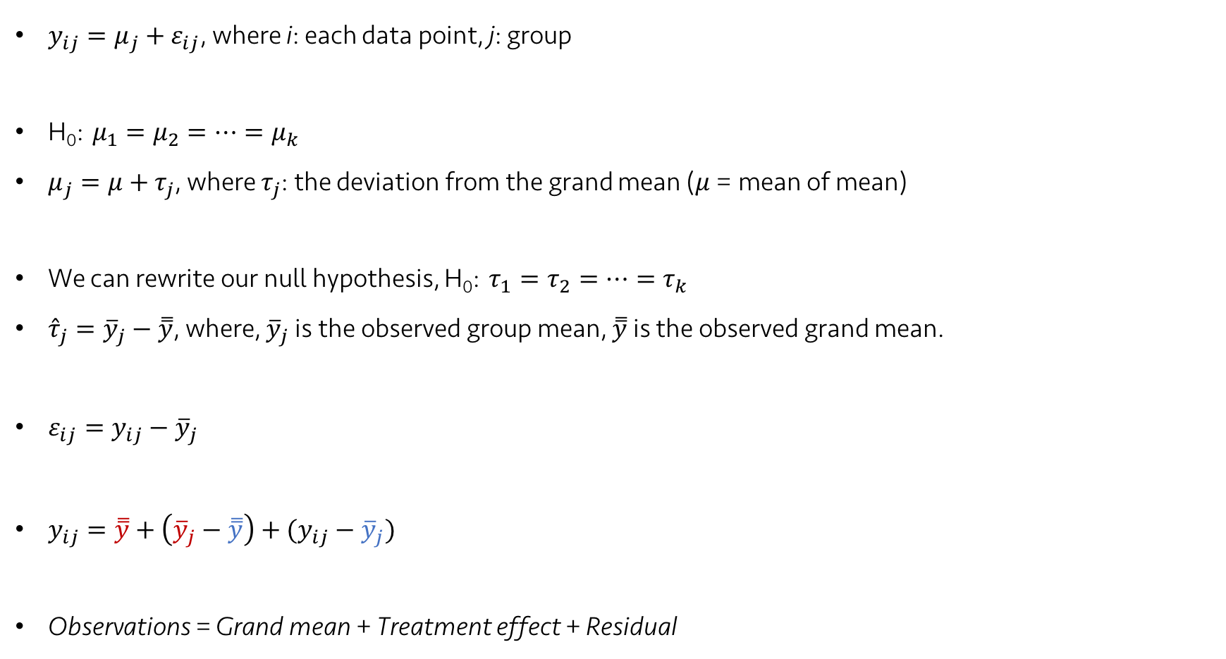
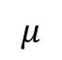
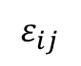
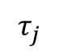
Lecture 23
One-way ANOVA model
$y_{ij}=μ_{j}+ε_{ij}$, where i: each data point, j: group
H₀: $μ_{1}=μ_{2}=…=μ_{k}$
$μ_{j}=μ+τ_{j}$, where $τ_{j}$: the deviation from the grand mean ($μ$ = mean of mean)
We can rewrite our null hypothesis, H₀: $τ_{1}=τ_{2}=…=τ_{k}$
${\hat{τ}}_{j}={\overline{y}}_{j}−\overset{̿}{y}$, where, ${\overline{y}}_{j}$ is the observed group mean, $\overset{̿}{y}$ is the observed grand mean.
$ε_{ij}={y_{ij}−\overline{y}}_{j}$
$y_{ij}=\overset{̿}{y}+\left({\overline{y}}_{j}−\overset{̿}{y}\right)+({y_{ij}−\overline{y}}_{j})$
Observations = Grand mean + Treatment effect + Residual
$$μ$$
$$τ_{j}$$
$$ε_{ij}$$
CHOONG-WAN WOO | COCOAN lab | http://cocoanlab.github.io

Slide 12
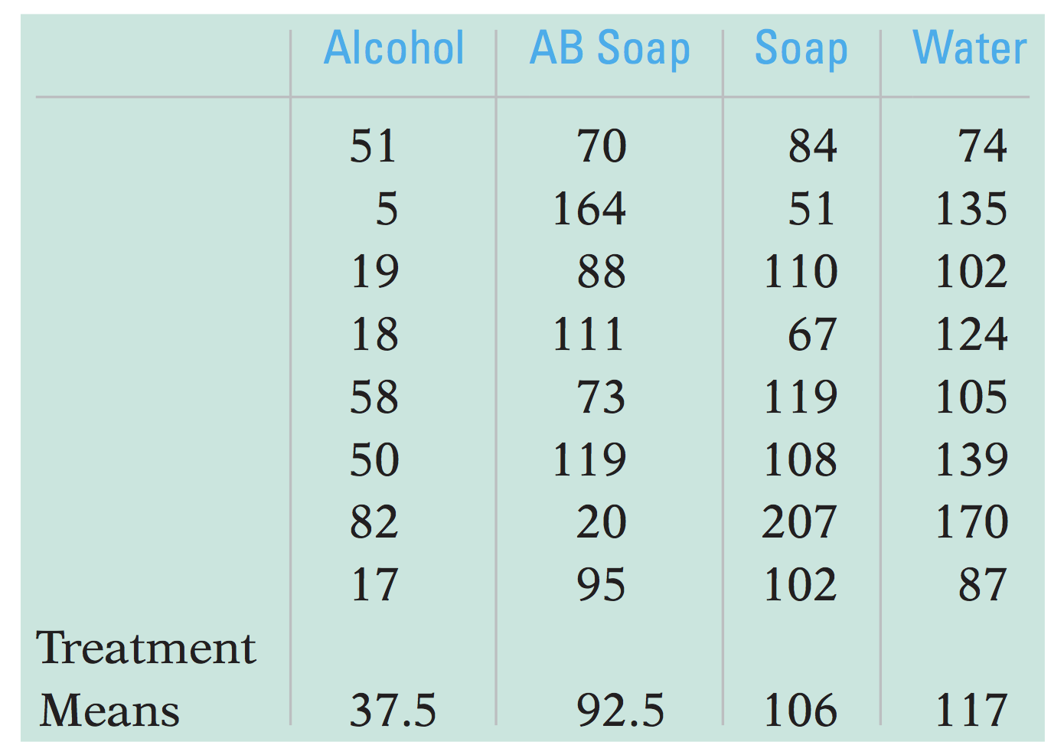
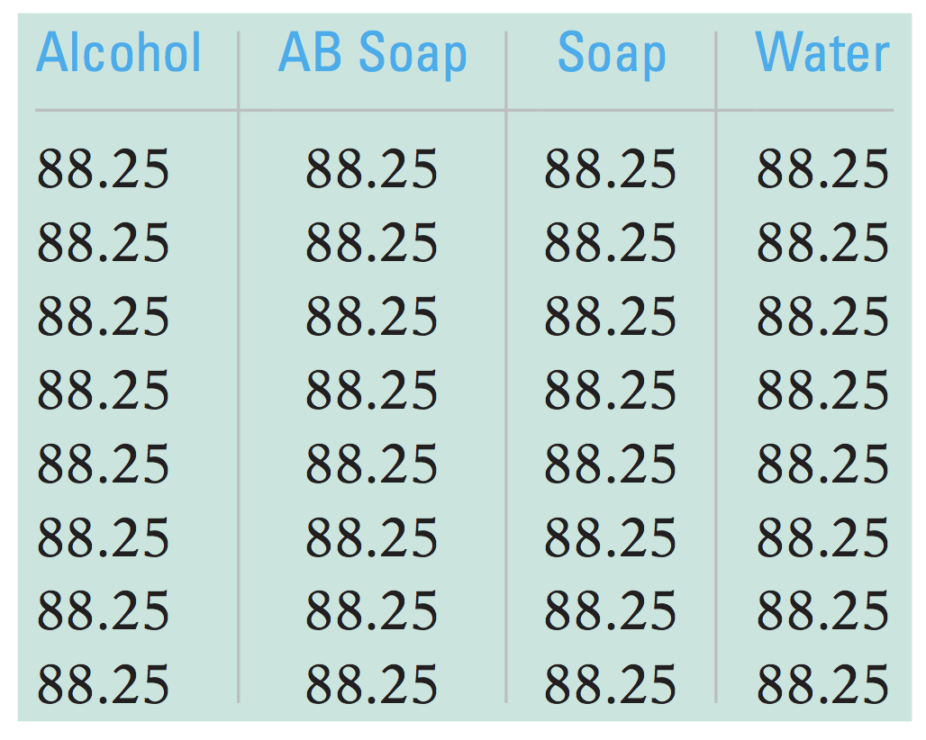
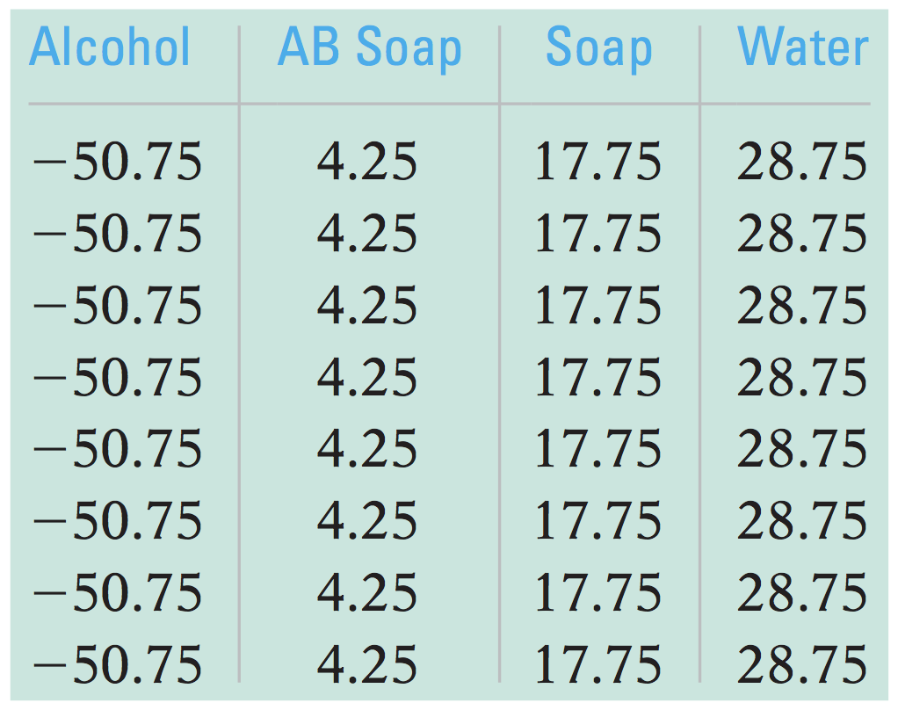
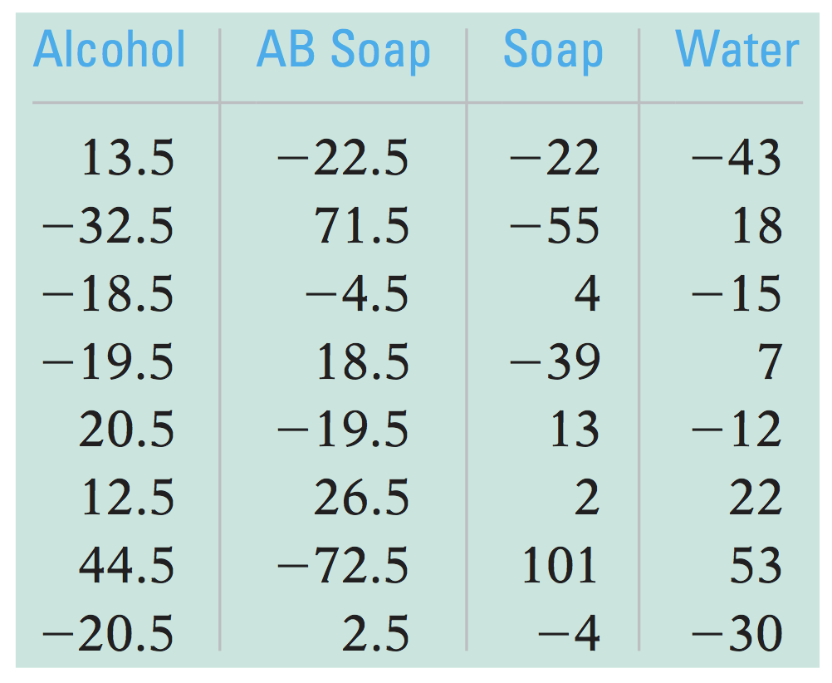
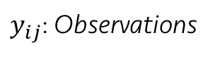
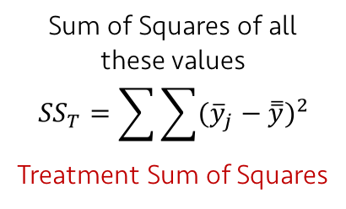
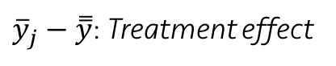
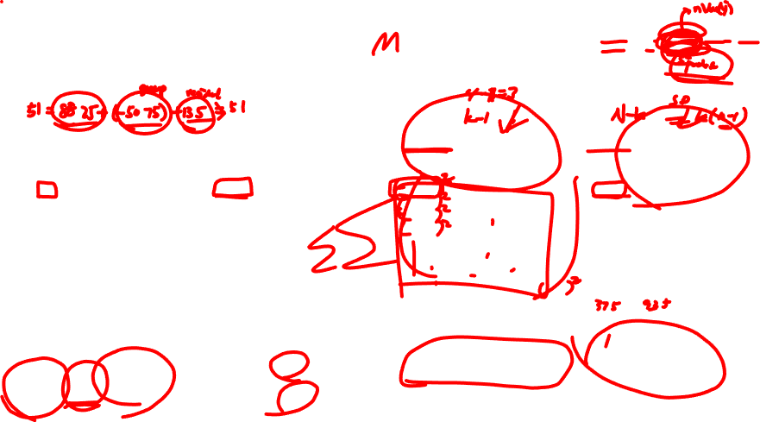
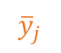
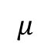
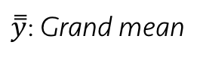
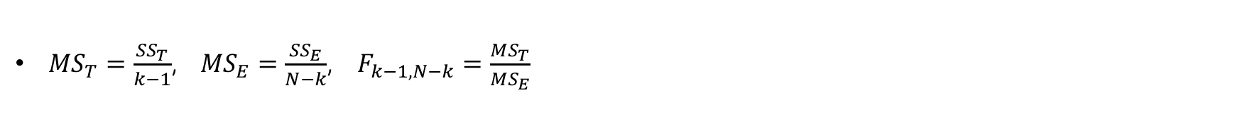
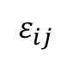
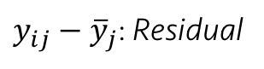
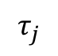
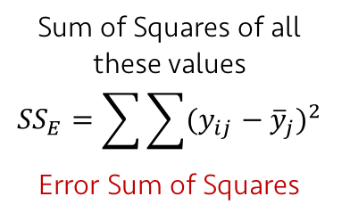
Lecture 23
Let’s look at the data
$y_{ij}=\overset{̿}{y}+\left({\overline{y}}_{j}−\overset{̿}{y}\right)+({y_{ij}−\overline{y}}_{j})$
$$μ$$
$$τ_{j}$$
$$ε_{ij}$$
$y_{ij}$: Observations
$\overset{̿}{y}$: Grand mean
${\overline{y}}_{j}−\overset{̿}{y}$: Treatment effect
${y_{ij}−\overline{y}}_{j}$: Residual
=
+
+
Sum of Squares of all these values
$${SS}_{T}=\sum{\sum{{({\overline{y}}_{j}−\overset{̿}{y})}^{2}}}$$
Treatment Sum of Squares
Sum of Squares of all these values
$${SS}_{E}=\sum{\sum{{({y_{ij}−\overline{y}}_{j})}^{2}}}$$
Error Sum of Squares
$${\overline{y}}_{j}$$
${MS}_{T}=\frac{{SS}_{T}}{k−1}$, ${MS}_{E}=\frac{{SS}_{E}}{N−k}$, $F_{k−1,N−k}=\frac{{MS}_{T}}{{MS}_{E}}$
CHOONG-WAN WOO | COCOAN lab | http://cocoanlab.github.io

Slide 13
Lecture 23
Quiz 23-2
https://forms.gle/cdzfzo2eGbq1DvYm7
CHOONG-WAN WOO | COCOAN lab | http://cocoanlab.github.io

Slide 14
Lecture 23
Quiz 23-3
https://forms.gle/gwrmqwzfrU9cLiqd6
CHOONG-WAN WOO | COCOAN lab | http://cocoanlab.github.io

Slide 15
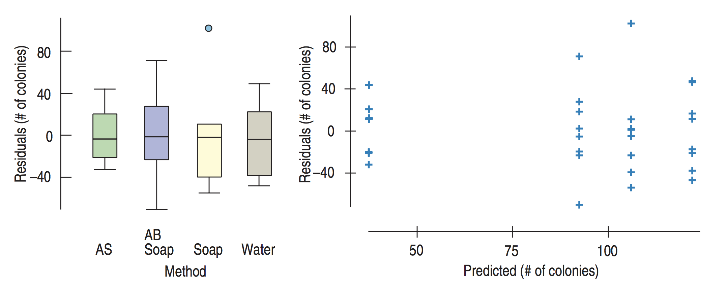
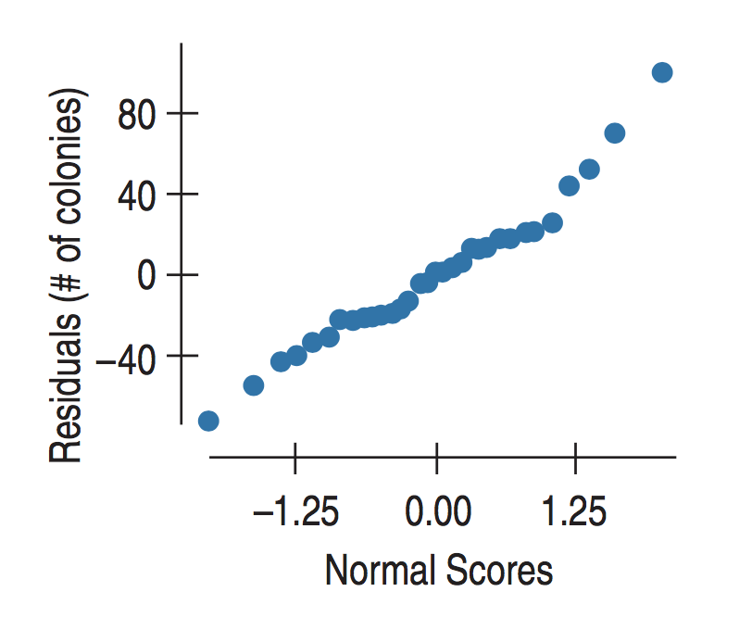
Lecture 20 | 112817
Assumptions and Conditions
Independence Assumption
1. Groups must be independent of each other.
2. Data within each treatment group must be independent.
Randomization Condition
Equal Variance Assumption
Similar Spread Condition
Normal Population Assumption
Nearly Normal Condition
Normal probability plot (using all the residuals)
CHOONG-WAN WOO | COCOAN lab | http://cocoanlab.github.io

Slide 16
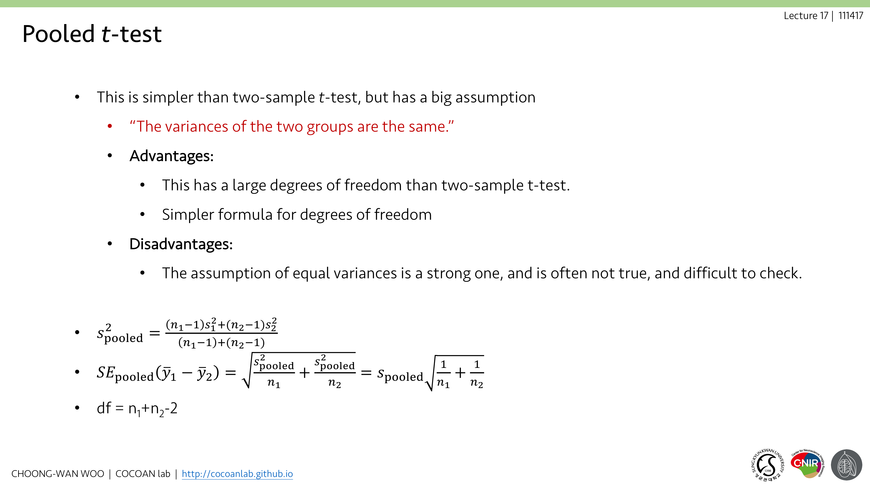
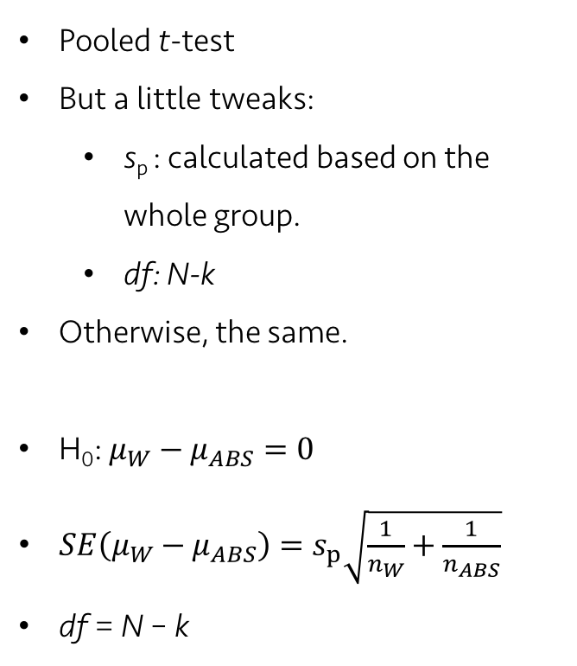
Lecture 20 | 112817
Comparing means
Pooled t-test
But a little tweaks:
s_{p} : calculated based on the whole group.
df: N-k
Otherwise, the same.
H₀: $μ_{W}−μ_{ABS}=0$
$SE\left(μ_{W}−μ_{ABS}\right)=s_{p}\sqrt{\frac{1}{n_{W}}+\frac{1}{n_{ABS}}}$
df = N – k
CHOONG-WAN WOO | COCOAN lab | http://cocoanlab.github.io

Slide 17
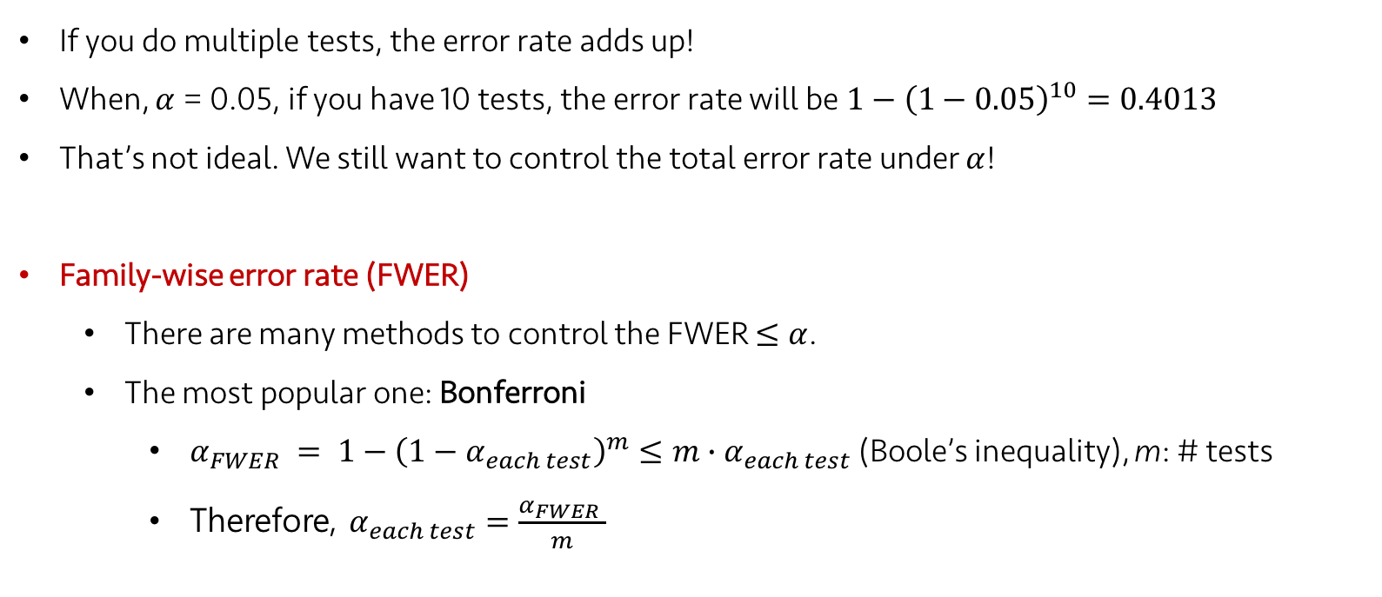
Lecture 20 | 112817
Correction for multiple comparisons
If you do multiple tests, the error rate adds up!
When, $α$ = 0.05, if you have 10 tests, the error rate will be $1−{\left(1−0.05\right)}^{10}=0.4013$
That’s not ideal. We still want to control the total error rate under $α$!
Family-wise error rate (FWER)
There are many methods to control the FWER $≤α$.
The most popular one: Bonferroni
$α_{FWER} = 1−{\left(1−α_{each test}\right)}^{m}≤m{∙α}_{each test}$ (Boole’s inequality), m: # tests
Therefore, $α_{each test}=\frac{α_{FWER} }{m}$
CHOONG-WAN WOO | COCOAN lab | http://cocoanlab.github.io

Slide 18
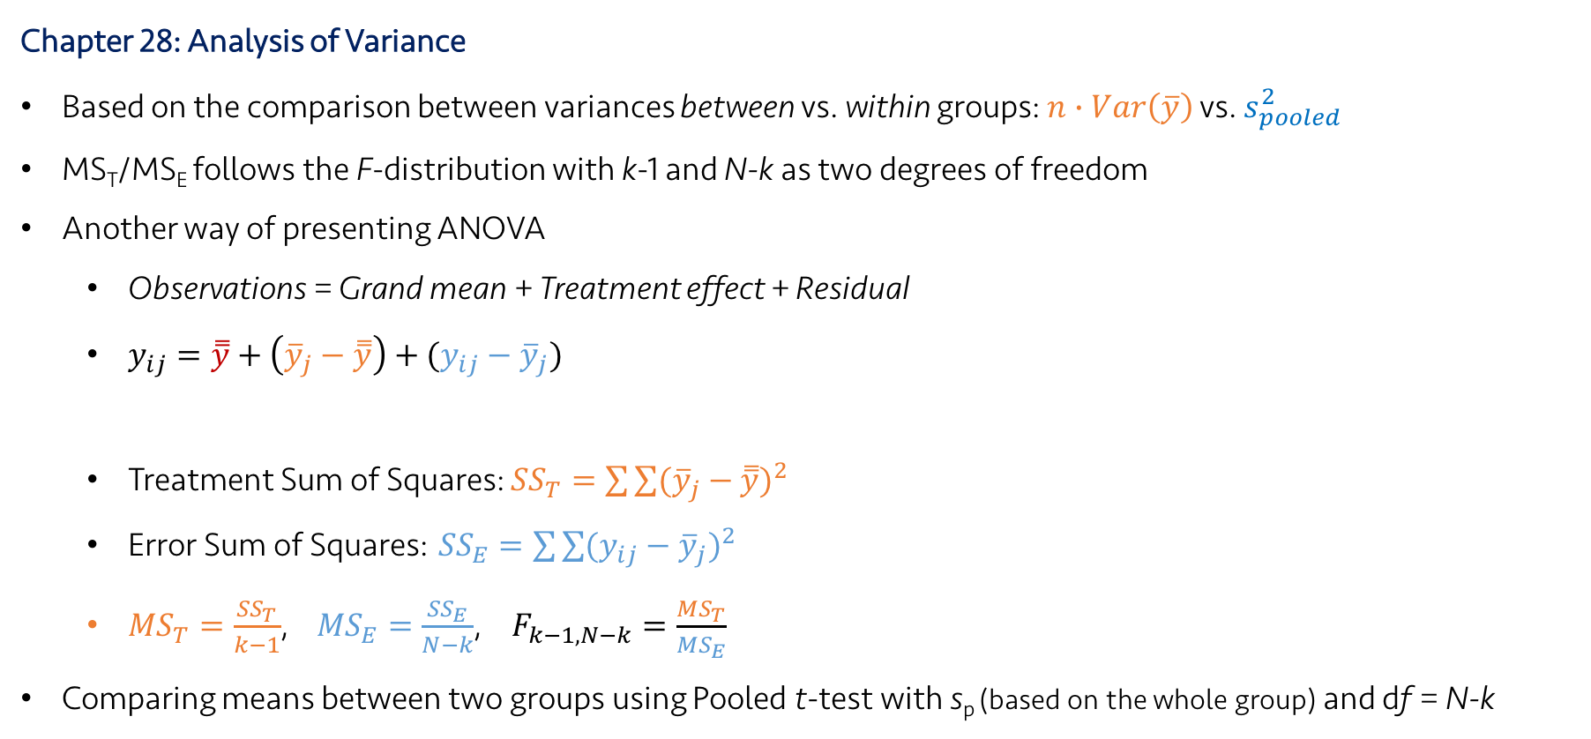
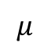
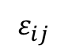
Lecture 23
Key Points
Chapter 28: Analysis of Variance
Based on the comparison between variances between vs. within groups: $n∙Var\left(\overline{y}\right)$ vs. $s_{pooled}^{2}$
MS_{T}/MS_{E} follows the F-distribution with k-1 and N-k as two degrees of freedom
Another way of presenting ANOVA
Observations = Grand mean + Treatment effect + Residual
$y_{ij}=\overset{̿}{y}+\left({\overline{y}}_{j}−\overset{̿}{y}\right)+({y_{ij}−\overline{y}}_{j})$
Treatment Sum of Squares: ${SS}_{T}=\sum{\sum{{({\overline{y}}_{j}−\overset{̿}{y})}^{2}}}$
Error Sum of Squares: ${SS}_{E}=\sum{\sum{{({y_{ij}−\overline{y}}_{j})}^{2}}}$
${MS}_{T}=\frac{{SS}_{T}}{k−1}$, ${MS}_{E}=\frac{{SS}_{E}}{N−k}$, $F_{k−1,N−k}=\frac{{MS}_{T}}{{MS}_{E}}$
Comparing means between two groups using Pooled t-test with s_{p} (based on the whole group) and df = N-k
$$μ$$
$$τ_{j}$$
$$ε_{ij}$$
CHOONG-WAN WOO | COCOAN lab | http://cocoanlab.github.io

